Slide 1



SMART INDIA HACKATHON 2026
  Problem Statement ID- 26188
  Problem-Statement Title- Al-Based Fake Identity & Document Screening System
  Theme- Blockchain & Cybersecurity
  PS Category- Software
  Team ID-
  Team Name- Pehchaan

Slide 2
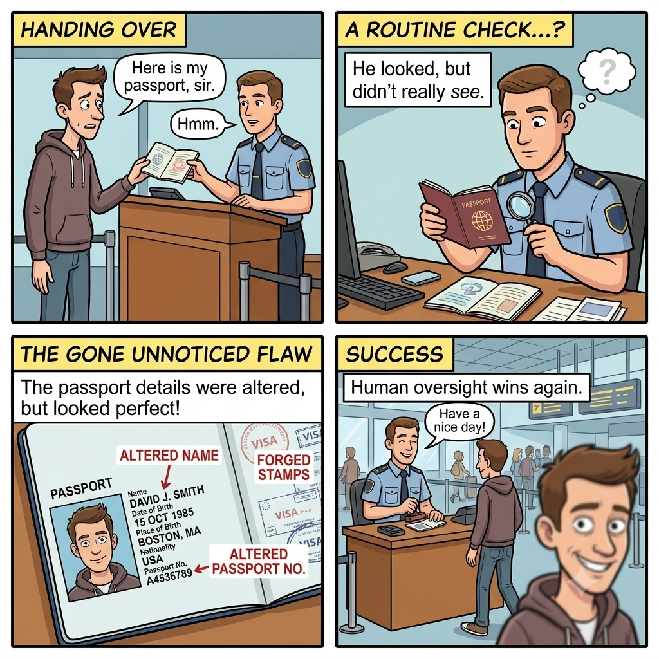
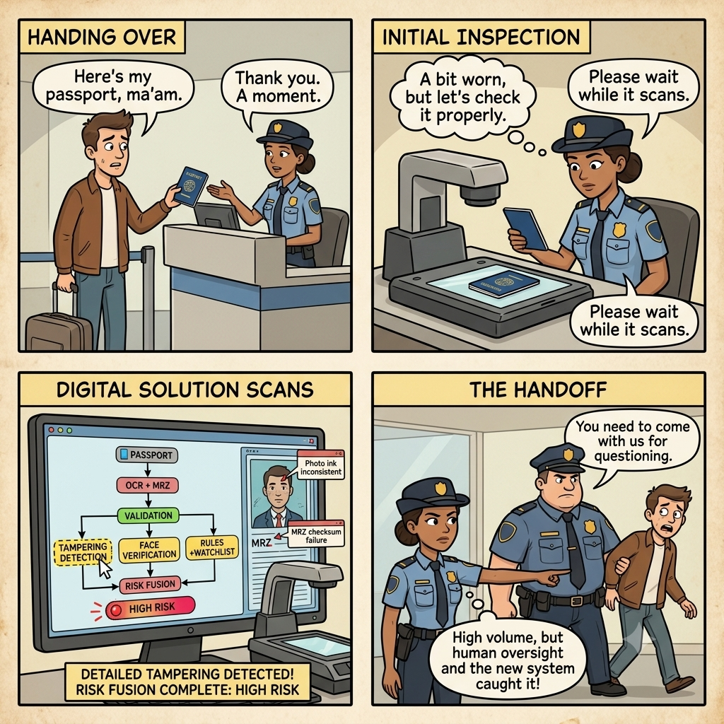
AI-POWERED PASSPORT AUTHENTICITY ENGINE
Pehchaan!
ये है आम ज़िंदगी
और ये है mentos ज़िंदगी

Slide 3
TECHNICAL APPROACH
Pehchaan!
@SIH Idea submission- Template
3

Slide 4
FEASIBILITY AND VIABILITY
Pehchaan!!
FEASIBILITY
VIABILITY
  Proven tech stack — no unproven research.
  Modular design enablesphased rollout.
  On-prem deployable — meets data sovereignty.
  Fits govt mandate — officer retains authority.
  Minutes to seconds — major efficiency gain.
  Extensible to visas, IDs, licenses.
FEASIBILITY AND VIABILITY
CHALLENGES AND RISKS
CHALLENGES AND RISKS
  Real-time processing under passenger bursts.
  False positives on degraded/rescanned docs.
  Data security & privacy of biometric data.
  Explainable AI for officer trust & audit.
  Hybrid edge/cloud compute architecture.
  Human-in-the-loop absorbs false positives.
@SIH Idea submission- Template
4

Slide 5
Pehchaan!
IMPACT AND BENEFITS
OPERATIONAL IMPACT
SECURITY & TRUST
(Immediate)
(Long-term)
01
⏱
Faster Verification
05
Data-Driven Risk Assessment
•
▥
Minutes → seconds per document.
Quantified score (0–100) + key factors.
02
⌕
Sharper Fraud Detection
06
⌕
Investigation Trail
Catches tampering, fake docs & forgeries.
•
OCR, checks, signals, score & decision → replayable.
03
✓
Standardized Screening
07
✓
Fraud Deterrence
Consistent, explainable scoring across checkpoints.
•
Multi-signal checks make fraud harder to pull off.
04
▤
Scalable Under Load
08
▣
Accountability
Kafka-driven throughput for peak travel periods.
•
Immutable audit trail via Hyperledger.
SMARTER VERIFICATION. STRONGER SECURITY.
FASTER • FAIRER • TRACEABLE • SCALABLE

Slide 6
RESEARCH AND REFERENCES
Your Team Name
  Details / Links of the reference and research work
@SIH Idea submission- Template
6

Slide 7
IMPORTANT INSTRUCTIONS
Please ensure below pointers are met while submitting the Idea PPT:
  Kindly keep the maximum slides limit up to six (6). ( Including the title slide)
  Try to avoid paragraphs and post your idea in points /diagrams / Infographics /pictures
  Keep your explanation precise and easy to understand
  Idea should be unique and novel.
  You can only use provided template for making the PPT without changing the idea details pointers (mentioned in previous slides).
  You need to save the file in PDF and upload the same on portal. No PPT, Word Doc or any other format will be supported.
  Note - You can delete this slide (Important Pointers) when you upload the details of your idea on SIH portal.
@SIH Idea submission- Template
7

Slide 8
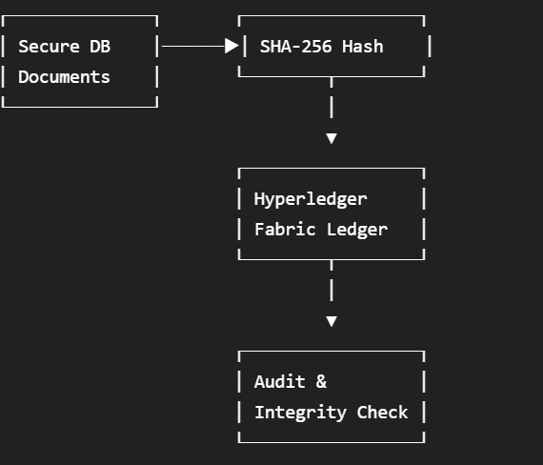
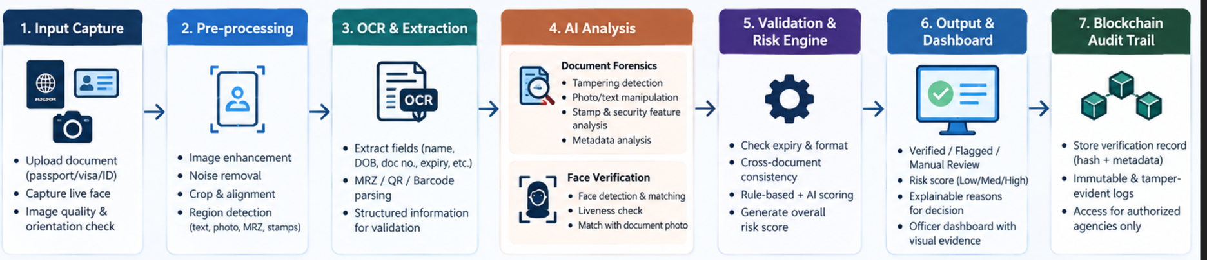
1. What exactly are we putting on the blockchain?
NOT this:
  Passport image ❌
  Face image ❌
  Name / DOB / nationality ❌
  Full OCR output ❌
  Any sensitive PII ❌
Instead, blockchain stores a tamper-evident verification record.
For every screening:
Verification ID
Timestamp
Document Type
Document Hash
Verification Result
Risk Score
Detection Summary Hash
Officer/System ID
Example:
VERIFICATION ID: VK-2026-00184
Document Hash: 8f31a9...c72e
Timestamp: 07-09-2026 23:41:08
Result: FLAGGED
Risk Score: 82
Reason: DOCUMENT_TAMPERING
System ID: CHECKPOINT-04
If somebody later changes the underlying verification record, the hash no longer matches.
AI Verification
↓
Generate Verification Record
↓
SHA-256 Document Hash
↓
Permissioned Blockchain
(Hyperledger Fabric)
↓
Immutable Audit Trail
↓
Integrity Verification

